Slide 1
Treatment:
Major Indication | Fluid | Intracellular | Interstitial | Intravascular
Dehydration | D5W | 667 mL | 250 mL | 83 mL
Maintenance fluid | D5 + 1/2NS | 333 mL | 500 mL | 167 mL
Intravascular repletion in symptomatic patients | NS or LR | 0 | 750 mL | 250 mL
Severe SYMPOTOMATIC hyponatremia | 3% NaCL | 0 | 750 mL | 250 mL +
Intravascular repletion for symptomatic patients with fluid restriction | Albumin 5% |  |  | 1000 mL

Slide 2
Goals | Values
Urine Output | 0.5 – 1 mg/kg/hr
Plasma Osmolality | 280 – 310 mOsm/kg
Calculated osmolarity =
2*Na +
Glucose
18
+
BUN
2.8
Normal Solute lvls | ECF | ICF
Sodium | 140 mEq/L | 10 mEq/L
Chloride | 105 mEq/L | 0 mEq/L
Bicarb | 25 mEq/L | 10 mEq/L
Potassium | 4 mEq/L | 150 mEq/L
Magnesium | 2 mEq/L | 40 mEq/L
Sulfate/Phosphate | 5 mg/dL | 150 mg/dL

Slide 3
Fluids
Compartments
Calculations
Total Body Water
Holiday Segar method
Fluid loss
Causes (small intestine, urine, gastric, diarrhea, pancreas)
Effects on Volume and Concentration
Oral Vs Crystalloids Vs Colloids

Slide 4
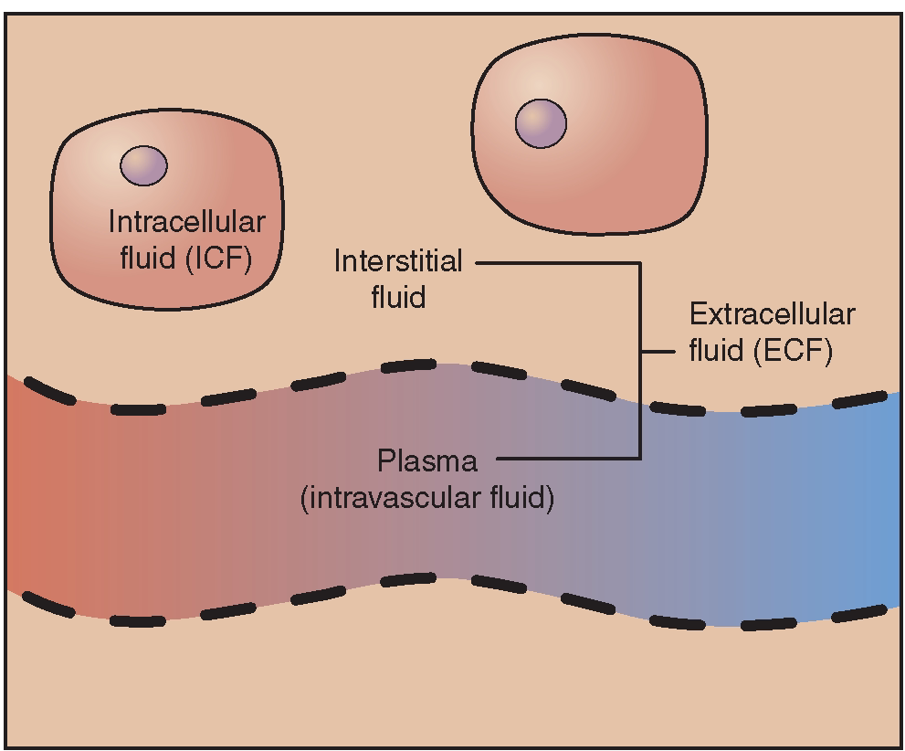
Fluids: Compartments

Slide 5
Fluid Compartments:
Male total body water = Weight * 0.6
Female total body water = Weight * 0.5
Total Body Water
60% Intracellular Fluid (ICF)
40% Extracellular Fluid (ECF)
75% of ECF contains
Interstitial Space
25% of ECF contains
Intravascular Space

Slide 6
Fluids
Compartments
Calculations
Total Body Water
Holiday Segar method
Fluid loss
Causes (small intestine, urine, gastric, diarrhea, pancreas)
Effects on Volume and Concentration
Oral Vs Crystalloids Vs Colloids

Slide 7
Holiday Segar Method
Step 1: Calculate maintenance fluid per hour
100 mg/kg | For the first 10 kg
50 mg/kg | For the next 10 kg
20 mg/kg | For anything over 20 kg
Daily Maintenance
Fluid Requirement
= 1500 mL + 20 mL (# of kg over 20kg)
Step 2:
Add 10% volume for each degree above 37 C
Step 3:
Reassess daily
Notes:
http://surgstudent.org/lectures/flud/node22.html

Slide 8
Fluids
Compartments
Calculations
Total Body Water
Holiday Segar method
Fluid loss
Causes (small intestine, urine, gastric, diarrhea, pancreas)
Effects on Volume and Concentration
Oral Vs Crystalloids Vs Colloids

Slide 9
Cause of Fluid Loss
If patient is losing fluids through one of these mechanisms, the type of IV would mimic the electrolytes the pt is losing.
Site | Na+ (mEq/L) | Cl- (mEq/L) | K+ (mEq/L) | HCO3- (mEq/L)
Small intestine | 135-140 | 90-130 | 5-15 | 30-40
Urine | 80 | - | 40 | -
Nasogastric | 40-64 | 100-140 | 10 | minimal
Diarrhea | 25-50 | 20-40 | 35-60 | 30-60
Pancreas | 120-140 | 90-120 | 5-15 | 60-115

Slide 10
Fluid Loss Effect on: Volume and Concentration
Volume | HyPOvolemia | HyPERvolemia
Compartment | ECF (outside cell) | ECF (outside cell)
Diagnosis | Retain Na | Urine Output < 0.5 mL/kg/hr
Labs | Weight gain from edema | ⬇BP ⬆HR ⬆RR ⬆SCr
Tx | Loop Diuretics | NS or Lactated Ringers
Concentration | Dehydration | Water intoxication
Compartment | ICF (inside cell) | ICF (inside cell)
Cause |  | ----
Labs | ⬇BP ⬆HR same as hypervolemia ⬆RR ⬆SCr | ----
Tx | D5W | ----

Slide 11
Fluids
Compartments
Calculations
Total Body Water
Holiday Segar method
Fluid loss
Causes (small intestine, urine, gastric, diarrhea, pancreas)
Effects on Volume and Concentration
Oral Vs Crystalloids Vs Colloids

Slide 12
Oral Rehydration Solutions
 | WHO- ROS | Pedialyte | Rehydralyte | Infalyte | Resol
Osmolality (275 – 290) | 311 | 249 | 304 | 200 | 269
Carbohydrates (g/L) | 13.5 as glucose | 25 as glucose | 25 as glucose | 30 as rice syrup | 20 as glucose
Calories (cal/L) | 65 | 100 | 100 | 126 | 80
Electrolytes (mEq/L)
Sodium | 75 | 45 | 75 | 50 | 50
Potassium | 20 | 20 | 20 | 25 | 20
Chloride | 65 | 35 | 65 | 45 | 50
Citrate |  | 30 | 30 | 34 | 34
Bicarbonate | 30
Calcium |  |  |  |  | 4
Magnesium |  |  |  |  | 4
Phosphate |  |  |  |  | 5

Slide 13
Crystalloids And Colloids
 | Crystalloids | Colloids
Contains | Na+ as the main particle | Contains large particles such as albumin, blood products, starch
Use | Utilized for volume expansion AND maintenance | Utilized for volume expansion
Permeability | will distribute in the EC compartment | Too large to cross the capillary membrane; therefore will remain in the intravascular space (vein)
Products | Isotonic Lactated Ringers (LR) NS: 154 mEq/L Hypertonic Tx brain injury 3% NaCl Hypotonic D5W (cell takes in) ½ NS | Starch: Hydroxyethyl starch (Hetastarch) Dextran Plasma expanders Albumin 5% and 25% Blood products Blood Fresh frozen plasma

Slide 14
Isotonic Solution Tx: hyPOvolemia | Tx | Na+ (mEq/L) | Cl- (mEq/L) | Dextrose (gm/dl) | Other | mOsm/L 275 – 290
Lactated Ringers | replete in S/S pts | 130 | 109 | 0 | Lactate Potassium Calcium | 273
NS | replete in S/S pts | 154 | 154 | 0 | 0 | 308
HyPOtonic Solution | Tx | Na+ (mEq/L) | Cl- (mEq/L) | Dextrose (gm/dl) | Other | mOsm/L 275 – 290
D5W | Dehydration | 0 | 0 | 5 | 0 | 253
1/2NS |  | 77 | 77 | 0 | 0 | 154
hyPERtonic Solution Tx: brain injury | Tx | Na+ (mEq/L) | Cl- (mEq/L) | Dextrose (gm/dl) | Other | mOsm/L 275 – 290
3% saline hypertonic | Brain injury | 513 | 513 | 0 | 0 | 1026

Slide 15
No difference between crystalloids (NS) Vs Colloids
Colloid Solution | Tx | Na+ (mEq/L) | Cl- (mEq/L) | Available formulations | mOsm/L 275 – 290
6% Hetastarch | ICU Fluid Resuscitation | 154 | 154 | Per 500 mL | 310
5% Albumin | ICU Fluid Resuscitation | 130-160 | 130-160 | Per 250-500 mL | 330
25% Albumin | ICU Fluid Resuscitation | 130-160 | 130-160 | Per 50- 100 mL | 330
A comparison of albumin and saline for fluid resuscitation in the intensive care unit
Showed no difference in outcomes in
hypovolemic patients 28 days
No difference in how quickly the patients’
volume status normalized and no difference
in mortality

